Slide 1
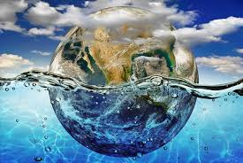
GO GREEN
Let us save the earth
-Atul sankar

Slide 2
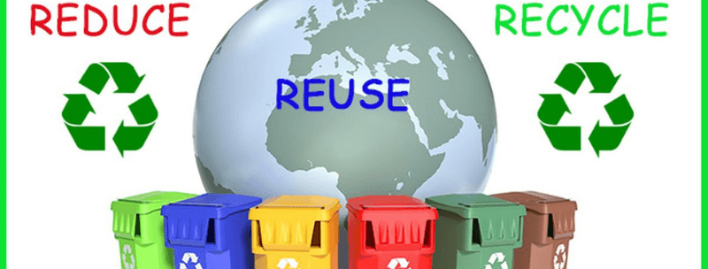
3R

Slide 3
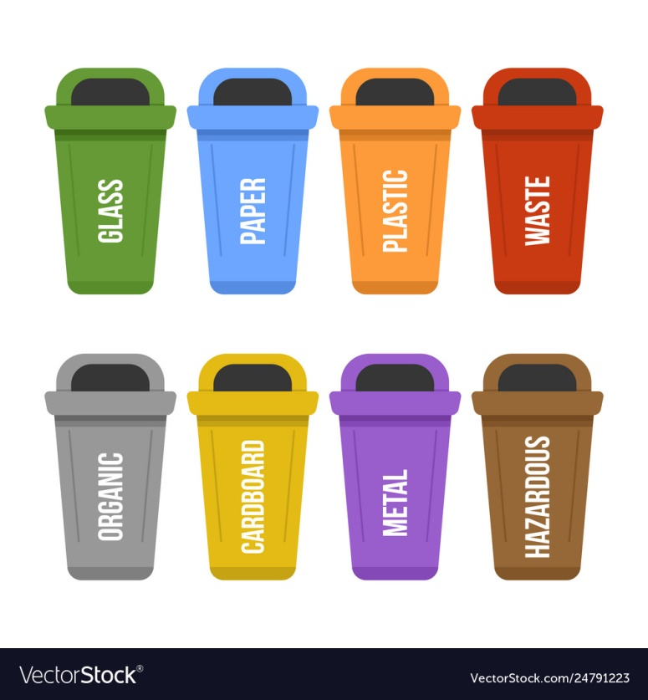
DIFFERENT BINS

Slide 4
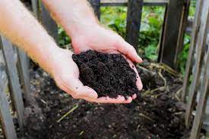
ORGANIC WASTE
Let the organic waste be composted
Composting can be done by natural and artificial process
It is very simple to learn
Consumer composting
Community coposting
Compost is known as black gold

Slide 5
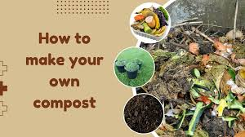

Slide 6
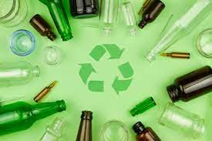
GLASS
Glass can be recycled or upcycled on what we decide to
Recycled to reuse the bottle
Can be converted hi grade silica sand
Upcycled to decorative house items
Extended producer resoponsibility

Slide 7
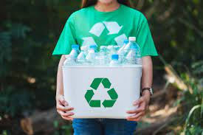
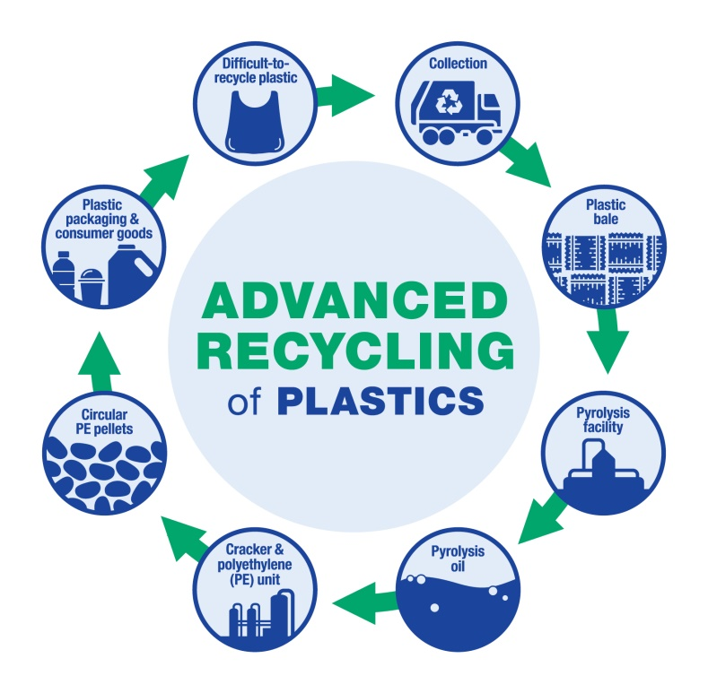
PLASTIC
Plastic can be segregated
Plastic can be easily converted to flakes and granules
Types of plastic
The remaininng plastic can be upcycled to furniture, bins , slabs , tiles

Slide 8
metal
Metal can be easily segregated
Types of metals
Converted to ingots and
Back to industry
High demand
Don’t find much
Upcycled to new decorative items

Slide 9
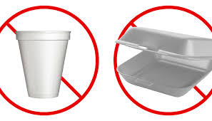
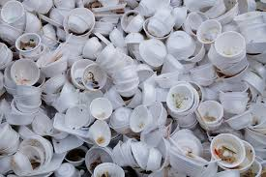
styrofoam
Biggest problem in the oceans and land fills
Government supported
Upcycling of Styrofoam
Recycling of Styrofoam
Re-use of styrofoam

Slide 10
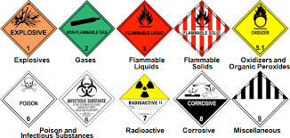
HAZARDOUS
Very conscious disposal
Government support
Best practices in the industry
Very harmful for the environment and ocean

Slide 11
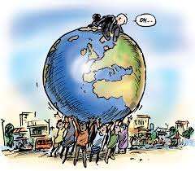
Citizen responsibility
Proper disposal of waste
Reduce your waste
Don’t go behind fast fashion and style
Use Electric modes of transport
Walk for small distances
Green appliances
Switch off the electricity when not in use

Slide 12


